Slide 1
Minor Project Code: 15ECSW302 Sem: VI Year: 2020-21
Project Title: Integer Factorisation using Shor’s Algorithm
Team Number: S3
Team Members:-
Guide Name: Mr. KMM Rajashekaraiah
NAME | USN
Raj Jain | 01FE18BCS002
Aayush Rajwade | 01FE18BCS005
Aman Kumar | 01FE18BCS029
Ayush Utsav | 01FE18BCS059

Slide 2
Project Overview / Summary
Domain/Problem Space :
Number Theory
Quantum Computing
Applications:
Breaking public key RSA Cryptography.
Enabling Quantum Cryptography.
Problem Definition :
To do Integer Factorisation by using Shor’s Quantum Algorithm.

Slide 3
Literature survey:
Paper Name | Author Name
QFT, Period Finding & Shor’s Algorithm. | William casper
Polynomial-time algorithms for prime factorization and discrete logarithms on a quantum computer | Peter W Shor.
A Note on Shor’s Quantum Algorithm for Prime Factorization | Zhengjun Cao
Quantum Algorithm Implementations for Beginners | Adetokunbo adedoyin and john ambrosiano

Slide 4
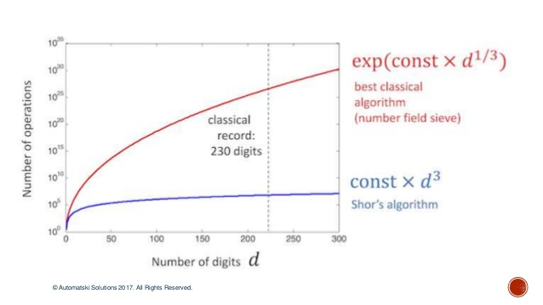
Goals/Objectives:
To do Integer Factorisation using Shor’s Quantum Algorithm.
To do factoring of large Integers in polynomial time.

Slide 5
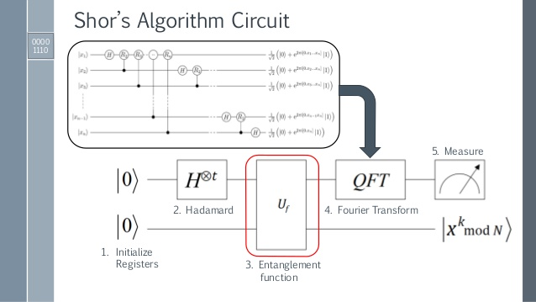
Proposed system / Solution

Slide 6
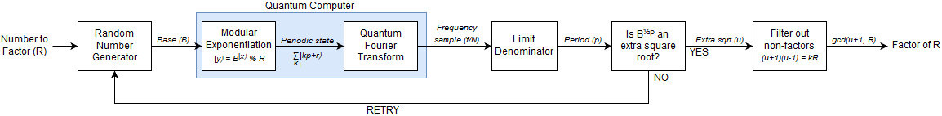
The proposed solution involves two major steps:-
Period Finding
Quantum Fourier Transform

Slide 7
Expected Results
Key performance indicators :
To increase the probability of prediction of factors.
To achieve factoring in polynomial time.
Major novelty / Observations / Conclusions :

Slide 8
Plan to Complete Project
Final Probable Deliverables :
Next steps to be implemented in the order:-
Step1: Order Finding
Step2: Period Finding
Step3: QFT
Step4: Factoring
Roadblock: To modify the Shor’s Algorithm circuit to increase the efficiency of prediction.

Slide 9
References
Abhijith, J., et al. "Quantum algorithm implementations for beginners." arXiv e-prints (2018): arXiv-1804.
Speiser, Jacqueline. "Implementing and Comparing Integer Factorization Algorithms.“
Steiger, Damian S., Thomas Häner, and Matthias Troyer. "ProjectQ: an open source software framework for quantum computing." Quantum 2 (2018): 49.

Slide 10
Thank You!!

